Slide 1
Recommending Travel Plans using Geo-Tagged photos
Harshitha Rao Thanneru
Mentor:
Dr. Vijay Raghavan

Slide 2
Travel Planning
Travel Planning is a package of actions designed to encourage safe, efficient and fun travel experience.
We are trying to recommend efficient travel paths for the given time/cost and destination that the user prefers.

Slide 3
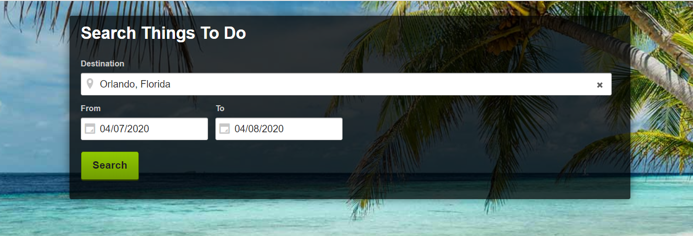
Travel Planning

Slide 4
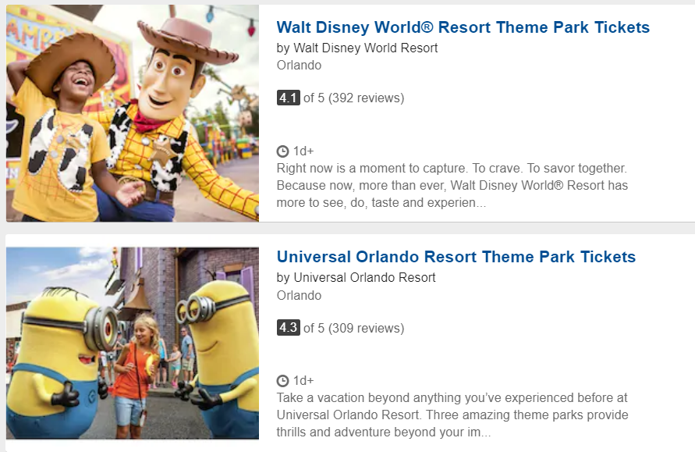
Other Systems

Slide 5
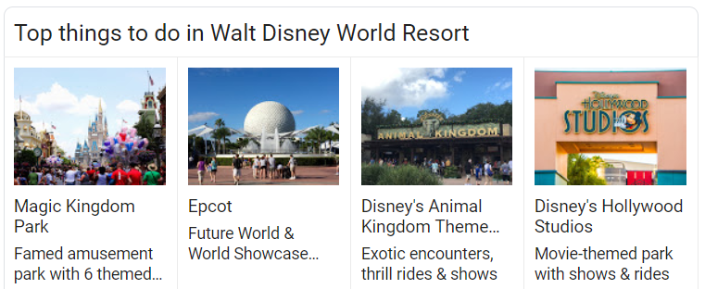
Our System – Recommending Bundles

Slide 6
Geo-Tagged Photos
A photograph associated with a geographical location (Latitude and Longitude).
Flickr.com

Slide 7
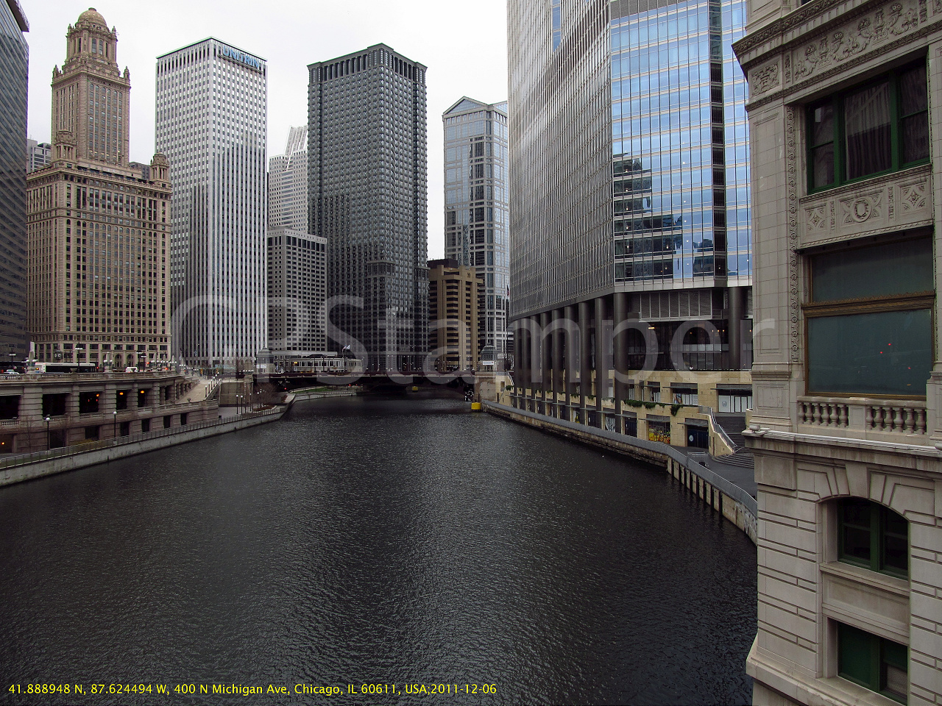

Slide 8
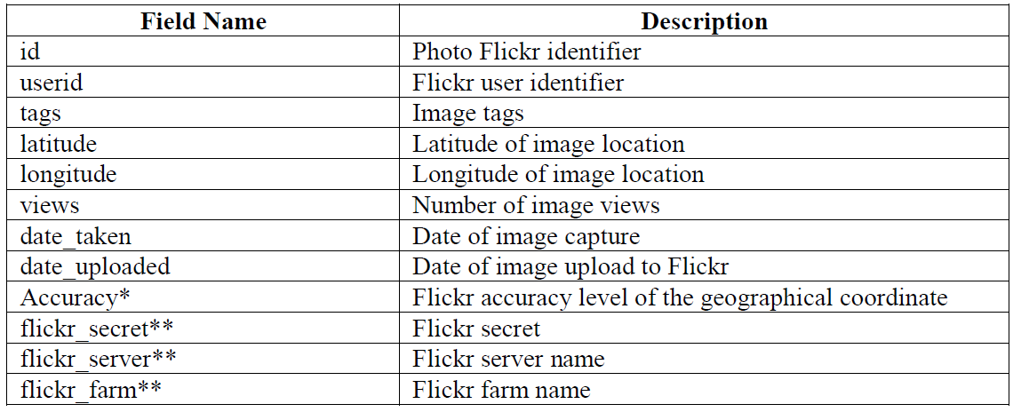

Slide 9
Sample Data FROM the Dataset
Field Name | Value
Id | 5372243616
User Id | 23877975@N04
Tags | DSC_0365 - Version 2
Latitude | 39.083297
Longitude | -84.510073
Views | {}
Date taken | 2010-11-27 00:44:34
Date Uploaded | 2011-01-20 06:48:45
Accuracy | 15
Flickr Secret | edaca3286c
Flickr Server | 52506474288.265982007
Flickr Farm | 4934762.664049473999499.30949791

Slide 10
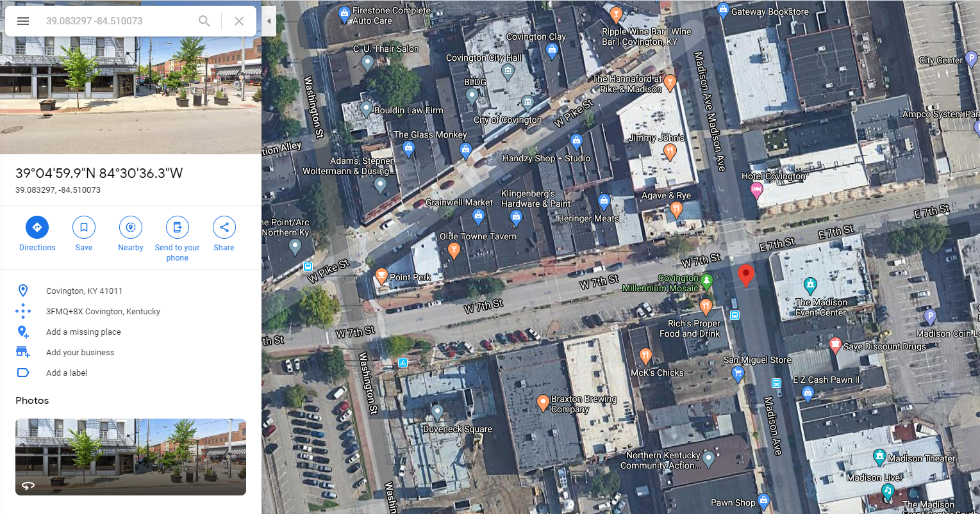

Slide 11
Your Assignment
Part 1 – Using Latitude and Longitude provided, find a popular Nearest Point of interest.
Eg : Given 28.476320, -81.457627 -> Universal studios, Orlando Fl is the Popular Nearest Point of Interest.
Part 2 – Using a Star Schema (Many to Many Relationships) Create an ER model.
We need following Entities definitely – Location, Time, User. You can derive more entities if you think they are needed. (Will discuss more on this when we can setup some time to talk.)
Part 3 – We would like to see you execute some queries on this ER model and get us the appropriate results.
Examples:
Given UserID, Date_taken, City, we would like to know how many pictures are present in this dataset?
Given Country, Time, Date , we would like to know the User ID’s of all people who visited the given country on the given time/date.
Create a Table (Aggregation) with all details for Location, Time Travelled by Each User.
Create a Table(Aggregation) with all details for Paths Travelled by different users to visit a Particular Location.

Slide 12
Contact for any questions
You can contact me at
C00252852@Louisiana.edu (UL Email)
Cherry.harshi@gmail.com (Personal Email) – I prefer this.
Harshitha.thanneru@cgi.com (Work Email)

Slide 13
Thank You

